Slide 1



PharmaCopilot AI
Intelligent Pharmaceutical Manufacturing Analytics & Quality Control

Slide 2

Agenda
0
1
2
3
Agenda
Introduction
Problem
Solution
4
5
6
Methodology
Architecture
Bussiness Impact

Slide 3
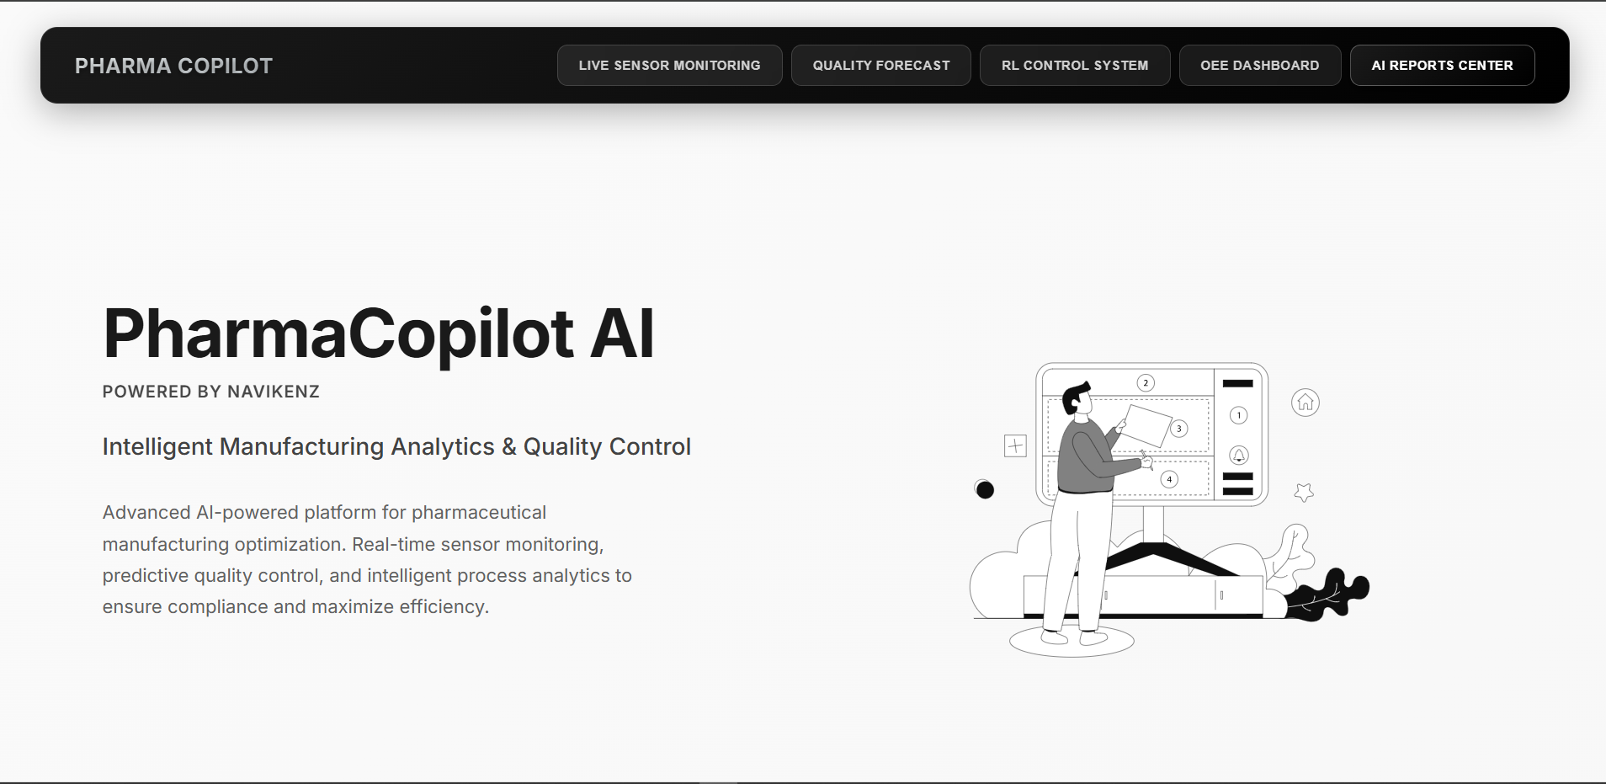
INTRODUCTION
The pharmaceutical industry stands at a critical juncture, constrained by manufacturing processes that rely on slow, reactive, and often wasteful quality control methods. These traditional approaches lead to significant financial loss and delay the delivery of vital medicines.
The Future of Pharma is Proactive, Not Reactive.

Slide 4
PROBLEM
Traditional manufacturing processes face significant financial and operational challenges due to their reactive nature. These inefficiencies lead to waste, delays, and missed opportunities.
The High Cost of Reactive Quality Control
Significant Financial Loss
Inefficient Sampling
Operational Delays
Statin-tablet plants lose approximately $1.2 million per year from batches rejected during final lab testing.
Traditional 10% sampling is inadequate, leaving 22% of high-risk periods under-tested and ignoring real-time process deviations.
The current process results in a 48-hour batch release time and requires 8 hours for manual report preparation, creating significant bottlenecks.

Slide 5



SOLUTION
PharmaCopilot AI shifts manufacturing reactive to proactive control by fusing three proven AI levers: Time-Series Forecasting, Safe Reinforcement Learning, and GenAI Reporting.
A Proactive, AI-Powered Platform
Predictive Quality Forecasts
Autonomous Process Adjustments
Automated Compliance Reporting
A safe Reinforcement Learning (RL) agent makes autonomous, real-time process adjustments. Trained on over 1 million simulated episodes, the system optimizes for throughput while ensuring all actions remain within strict safety and compliance limits.
Instantly generate comprehensive, 21 CFR 11-compliant reports. Our Retrieval-Augmented Generation (RAG) model, powered by Gemini 2.5 Flash, pulls data from batch logs and regulatory guidelines to create accurate, grounded reports in minutes, not hours.
Anticipate and prevent quality deviations before they occur. Our platform uses advanced time-series models to provide a 60-minute forecast of key quality parameters, giving operators a crucial window to act and prevent batch loss.
Technologies in use
AWS
Amplify, DynamoDB
S3, EKS, RDS
React
NextJS
N8N
PostgreSQL
Kubernetes
User features

Slide 6
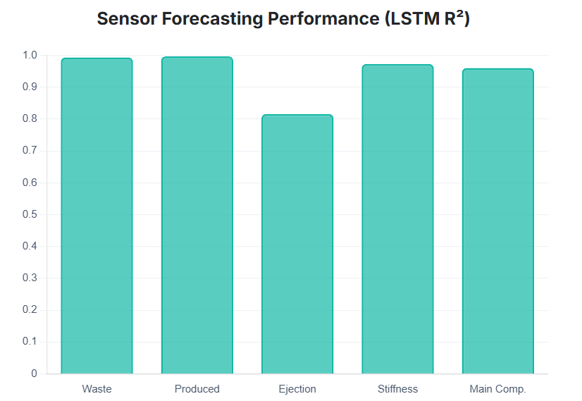
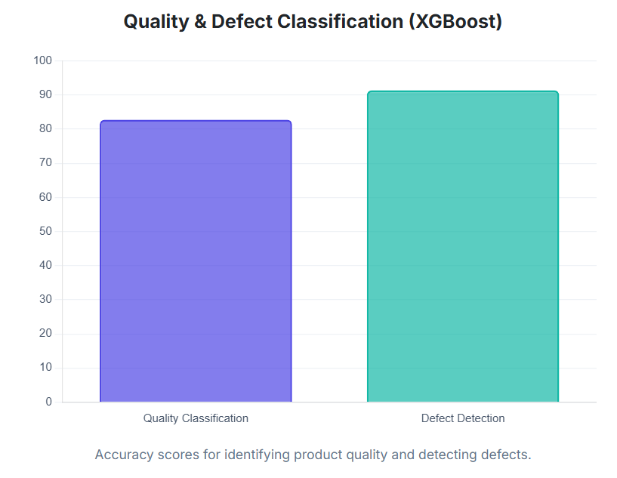
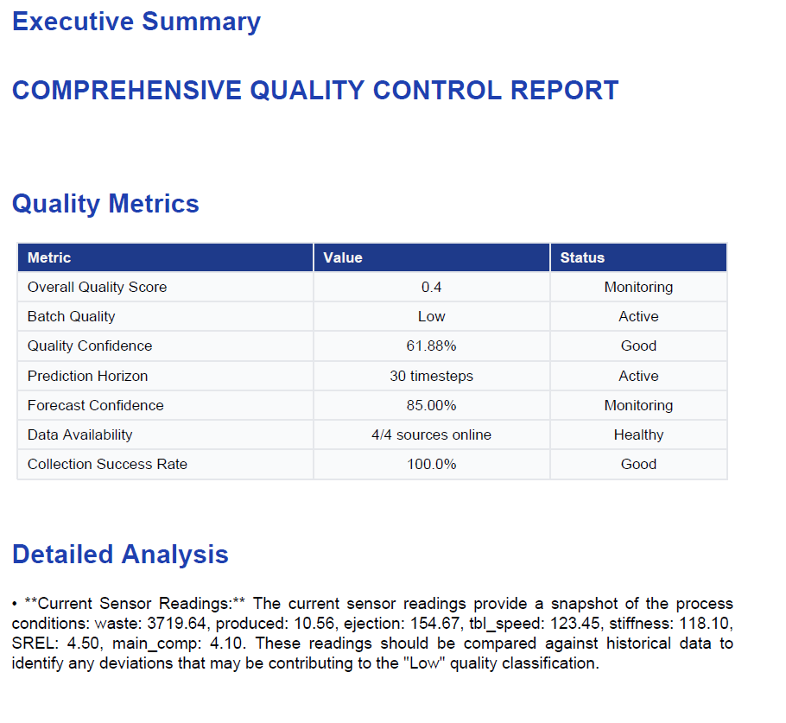
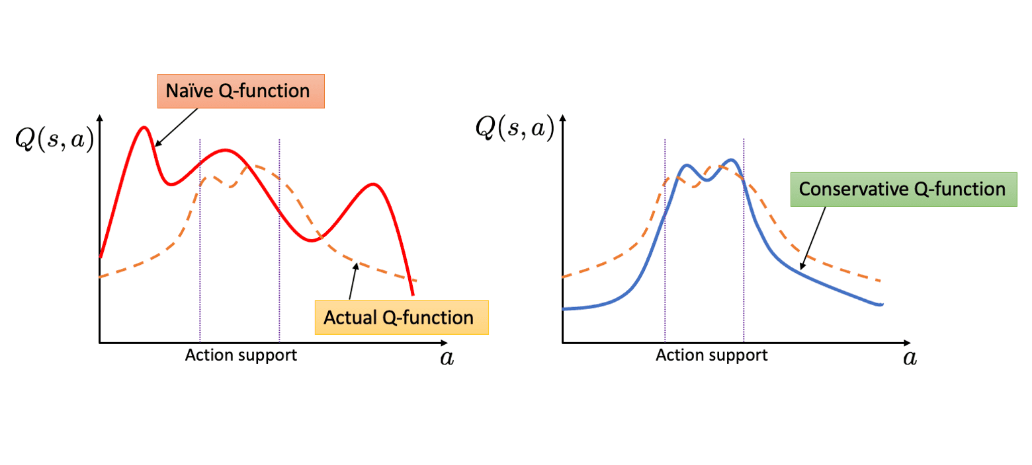
METHODOLOGY
Sensor Forecasting (LSTM)
Quality & Defect Classification (XGBoost)
RL Control System (CQL)
GenAI Reporting (RAG with Gemini)
Uses a deep learning LSTM model to analyze real-time sensor data and predict potential quality issues up to 60 minutes in the future.
Employs an XGBoost model to accurately classify the final product's quality and identify the probability of defects based on process parameters.
A safe Reinforcement Learning agent (CQL) autonomously adjusts machine settings in real-time to optimize production while guaranteeing process safety and compliance.
Leverages a sophisticated RAG model with Gemini to automatically generate comprehensive, regulation-compliant reports by synthesizing batch data and official guidelines.
Fusing Advanced AI for End-to-End Control

Slide 7
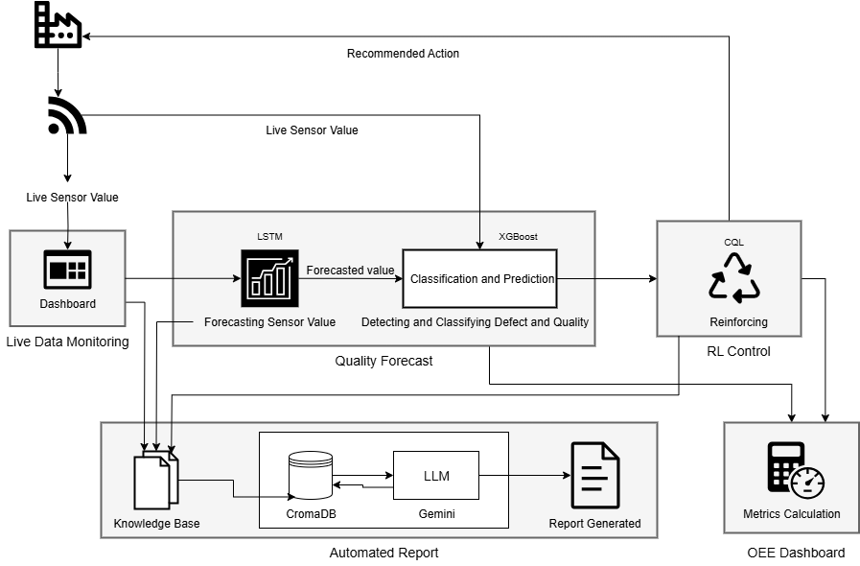
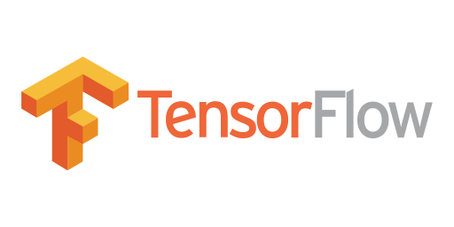
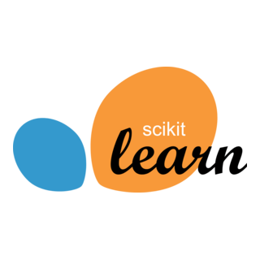
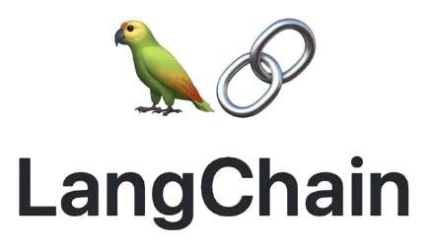



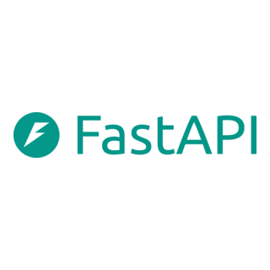



ARCHITECTURE
TECH STACK

Slide 8
BUSSINESS IMPACT
Achieved significant gains in efficiency, massive cost reductions, and a dramatic acceleration of our production cycle, fundamentally transforming our operational capabilities.
Transforming Manufacturing Efficiency & Compliance
Key Performance Indicators
Defect Detection Rate
Increased from 72% to 94% (+22 percentage points)
Batch Release Time
Reduced from 48 hours to just 6 hours (An 87% reduction)
Report Preparation Time
Slashed from 8 hours to 8 minutes (A 90% reduction)
Sampling Costs
Decreased by 33%, from $18k to $12k per batch

Slide 9

Feel Free to Ask Any Question
Thank You

